Slide 1
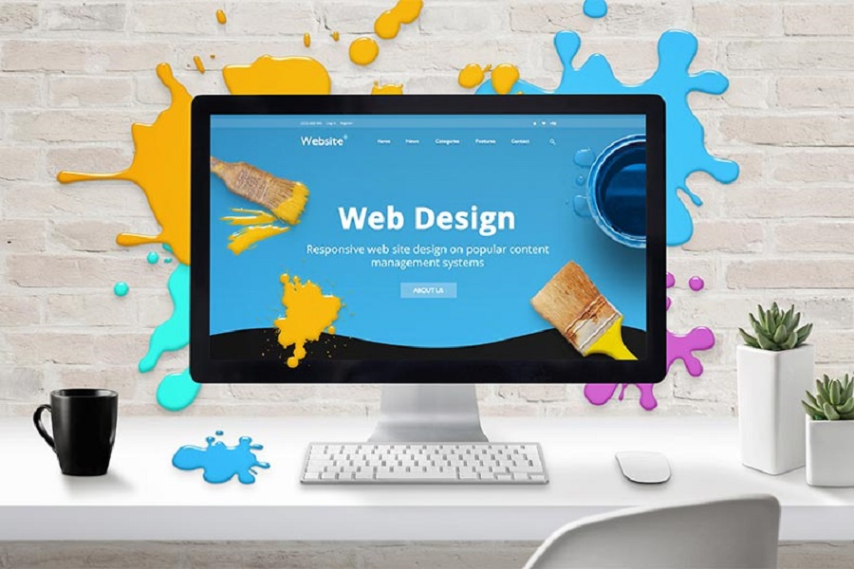
Websites and Webpages
Dr. Muhammad Habib

Slide 2
Websites and Webpages
You may have heard the terms webpages and websites, but what's the difference?
A web page is a document that displays images, texts, videos and other content in the web browser.
A website is a collection of webpages that link together.
Let's explore an example where you visit your favorite encyclopedia website.

Slide 3
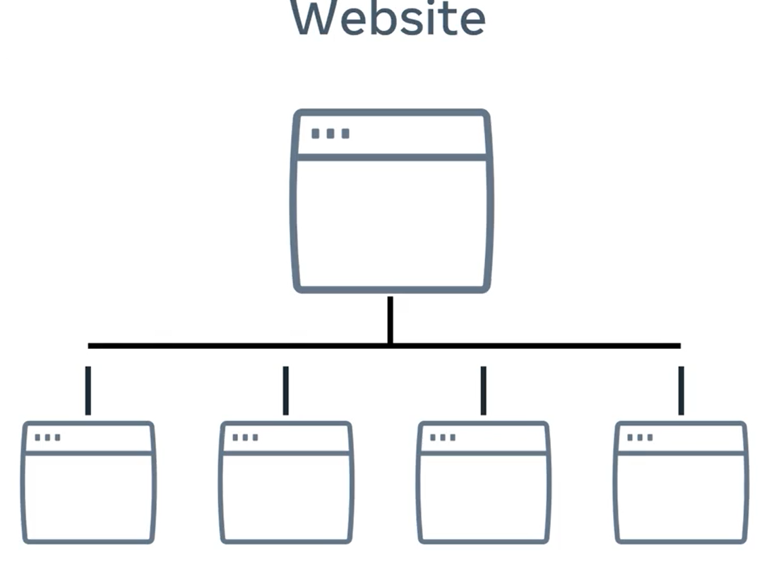
Websites and Webpages
When you arrive at the homepage, it contains many links to different articles clicking on one of those links brings you to a new webpage article and that article links to even more articles and other web pages.
If all these webpages have a similar address in the web browser's address, it can be safe to assume that they belong to the same website.

Slide 4
Websites and Webpages
However, the links on the page do not all have to link to the same website, they can also link to other websites.
For example, when you visit your favorite search engine and search for a phrase, the search results are a list of links to other websites.
Did you know that as I'm talking to you, thousands of websites are being launched to the internet.

Slide 5
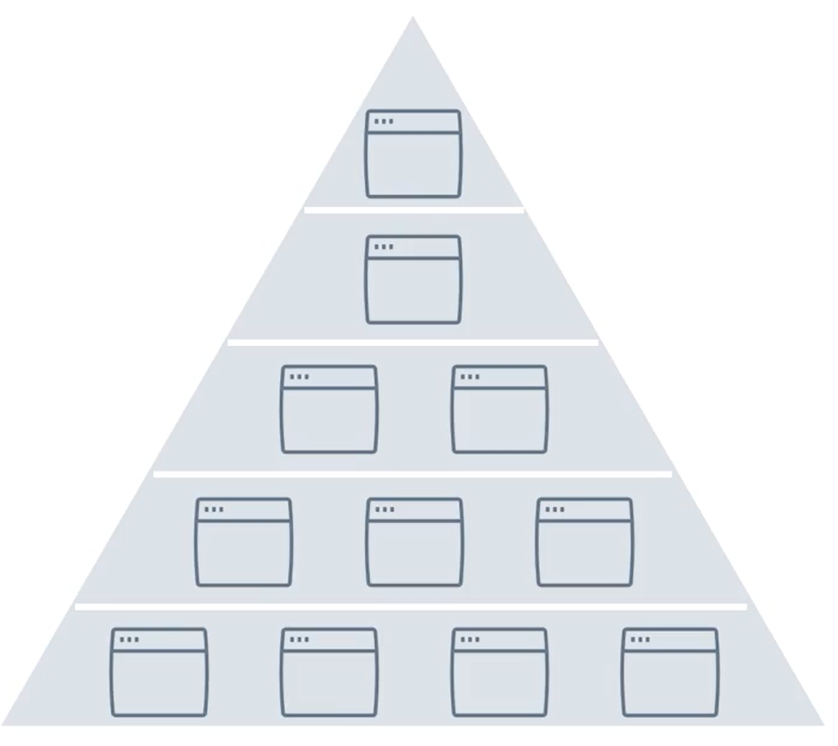
Websites and Webpages
Every day, hundreds of thousands of websites are launched, to put things into perspective the Great Pyramid of Giza has 2.3 million blocks of stone.

Slide 6
Websites and Webpages
So think about it, in one week there are as many new webpages as stones in the Great Pyramid.
With current internet speeds, it would take three million years to download all the webpages on the internet and all of these billions of varied webpages rely on the same core technologies.

Slide 7
Websites and Webpages
Most people interact with websites in some form daily, but few know how webpage actually works.
Let's explore that now. In its most basic form, a webpage is just a text document, you can open and edit with any text editor, but developers usually use more sophisticated tools for working with webpages.

Slide 8
Websites and Webpages
If you want to work with a webpage, you need to know about three technologies and understand how they interact.
They are
HTML,
CSS and
JavaScript.

Slide 9
Websites and Webpages
HTML structures the content you see, CSS controls the colors and style and JavaScript is responsible for the user interaction.
As a web developer you will work with these technologies every day and understand how they work together.

Slide 10
Websites and Webpages
I always like to imagine it like this, think of a shot, HTML is the actual building, the structure, CSS is the interior decoration and landscaping outside and JavaScript is just like the business, the services offered and the people coming in and out.

Slide 11
HTML
HTML stands for hypertext markup language, it works by using something called markup tags.
These tags describe the content that is displayed in the browser window, this content can be things like headings, paragraphs, images and even multimedia elements such as audio and video.
The way html describes the content is known as markup.

Slide 12
CSS
CSS is short for cascading style sheets and adds visual enhancements like colors and layout to the web page, this is commonly known as styling.
It works by enhancing the HTML elements and telling them how to display.
Have you ever noticed a friend changed their color or style of their hair? Well, your friend's hair is like the HTML and the color and style is CSS.

Slide 13
JavaScript
The last technology is JavaScript, which is a programming language built into the browser.
JavaScript provides web developers with tools for interactivity, data processing, control and action.
Have you ever tried to log to a website only to be told that the information you provided was incorrect or browse your favorite video streaming site and seen content update in real time?

Slide 14
JavaScript
Well, that's JavaScript in action, JavaScript is the powerhouse of a web page.
It has the ability to manipulate the content that you see on the screen as you interact with it.
In fact, without JavaScript websites would be kind of boring and very limited in terms of what you can do.

Slide 15
Page Rendering
You now know about the essential technologies of webpage.
But how exactly does this code get translated to display the content that you see on your screen?
When a copy of that webpage is sent from the web server to your browser, each line of code is processed in sequential order from first to last.

Slide 16
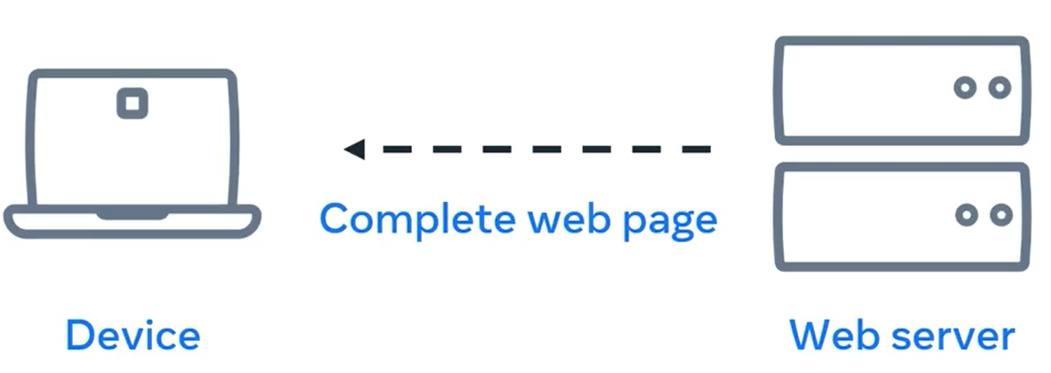
Page Rendering
As each line is interpreted, the browser creates the building blocks, which is the visual representation you see on the screen.
This creation process is known as page rendering, the response from the web server must be a complete web page in order to fulfill the request, to show the page in the browser.

Slide 17
Summary
You learned about the technologies that make up a webpage and how they interact with each other.
You also learned the page is rendered by the web browser to display what the end user sees on the screen.
In the time since you started taking this class, another few 1000 websites launched, everyone of them is another example of modern web developers building and adding to the ever growing internet.

Slide 18
Additional Resources
Learn more Here is a list of resources that may be helpful as you continue your learning journey.
What is a Web Server? (NGINX)
https://www.nginx.com/resources/glossary/web-server/
What is a Web Browser? (Mozilla)
https://www.mozilla.org/en-US/firefox/browsers/what-is-a-browser/
Who invented the Internet? And why? (Kurzgesagt)
https://youtu.be/21eFwbb48sE
What is Cloud Computing? (Amazon)
https://youtu.be/mxT233EdY5c
Browser Engines (Wikipedia)
https://en.wikipedia.org/wiki/Browser_engine

Slide 19
Thank You

